Slide 1
Camera Calibration & Single-View Geometry

Slide 2
What is Camera Calibration?
Camera calibration is the process of estimating the parameters of a camera so that we can relate 3D points in the world to their corresponding 2D projections on the image plane.
It removes distortions and provides a mathematical model of the camera.
Calibration involves finding two main types of parameters:

Slide 3
Camera Parameters
Intrinsic Parameters
Extrinsic Parameters
Internal to the camera.
Image formation in camera.
Examples:
Focal length (fx, fy)
Principal point (image center cx, cy)
Skew (non-rectangular pixels, usually negligible)
Lens distortion (radial, tangential)
Pose of the camera
Rotation matrix (orientation)
Translation vector (position)

Slide 4
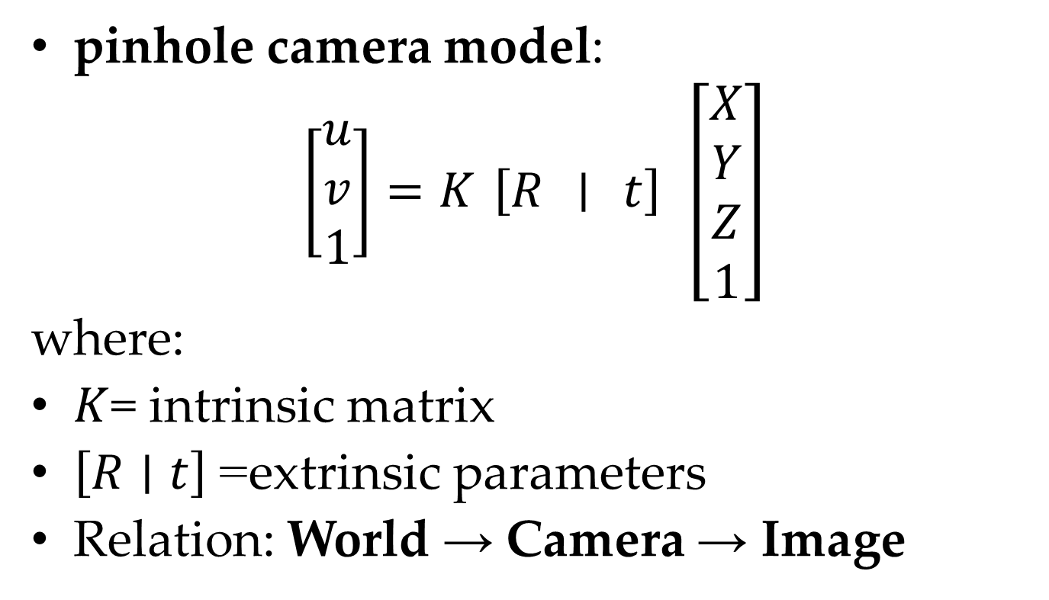
Mathematical Model
pinhole camera model:
$$\left[\begin{matrix}u \\ v \\ 1\end{matrix}\right]=K \left[R ∣ t\right] \left[\begin{matrix}X \\ Y \\ Z \\ 1\end{matrix}\right]$$
where:
$K$= intrinsic matrix
$\left[R∣t\right]$= extrinsic parameters
Relation: World → Camera → Image

Slide 5
Why Calibration is Needed?
Real cameras are not ideal (lens distortions, offset from image center, pixel scaling differences).
Without calibration, 3D reconstruction, measurements, or mapping would be inaccurate.

Slide 6
Influence on Single-View Geometry
Single-view geometry refers to the geometric relationships (like projection, vanishing points, perspective effects) seen in an image taken from a single viewpoint.
Calibration tells us the true mapping between scene geometry and its image.

Slide 7
Effects
Vanishing Points & Lines: Calibration determines how parallel lines in 3D converge to vanishing points in the image.
Metric Reconstruction: With calibration, we can measure real-world lengths, angles, and areas from a single image (not just projective geometry).
Camera Pose Estimation: Extrinsic calibration allows us to know where the camera is located in space relative to the scene.
Removing Distortion: Corrects curved lines (barrel/pincushion distortion) to recover accurate geometry.

Slide 8
Example: Checkerboard Calibration
Before calibration: curved edges, inaccurate distances
After calibration: straight edges, geometry preserved

Slide 9
In Short
Without calibration → only projective geometry (relative structure, parallelism lost).
With calibration → metric geometry (true shapes, angles, measurements possible).

